Slide 1
ALGEBRA 4
Day 43

Slide 2

Bell Work
Solve
$$1.) 0=−4x+12$$
$$2.) x^{2}−x=20$$

Slide 3
From Last Time
Page 245 #11 – 23 (odd), 38
Page 253 #39, 43

Slide 4
Objective
Solve quadratics with real and imaginary solutions

Slide 5
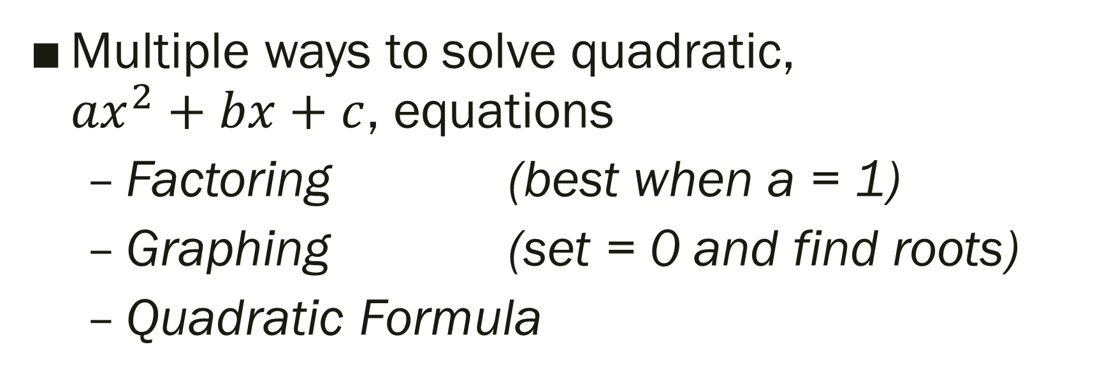
Quadratic Review
Multiple ways to solve quadratic, ${ax}^{2}+bx+c$, equations
Factoring (best when a = 1)
Graphing (set = 0 and find roots)
Quadratic Formula

Slide 6
The Quadratic Formula;
The solutions of the quadratic equation
ax² + bx + c = 0 are:
-- Can be used to solve any quadratic equation (instead of factoring or graphing)
--Must be in standard form; ax² + bx + c = 0

Slide 7
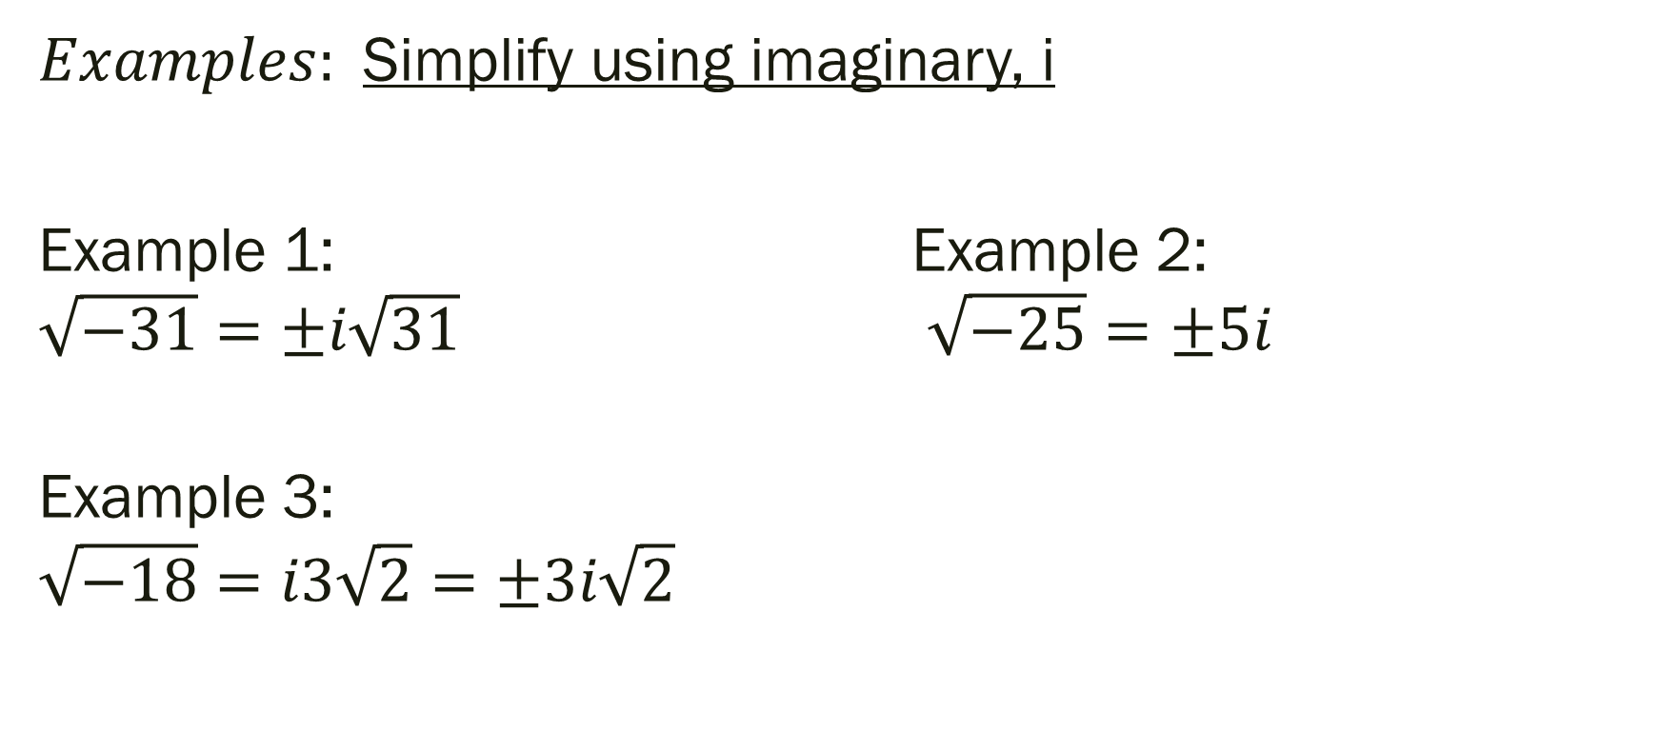
Imaginary Unit: i, defined as
or, i² = -1
$Examples:$Simplify using imaginary, i
Example 1: Example 2: $\sqrt{−31}=±i\sqrt{31}$ $\sqrt{−25}=±5i$
Example 3:
$$\sqrt{−18}=i3\sqrt{2}=±3i\sqrt{2}$$

Slide 8
Solving Quadratics Equations with Complex Solutions
If there is “b” = 0
1) Isolate the squared term on one side of the equation
2) Square root both sides
3) Substitute i = √-1 into equation and simplify radical
4) Write solution in Standard Form (a + bi)
If “b” has any value
1.) Use Quadratic Formula

Slide 9

Solve:
1.) $5x^{2}= 20$
2.) x² + x = 6
3.) 3x² – 17x + 10 =0
4.) $\text{x}\text{2}\text{ = −9 }$

Slide 10

Examples:
1.) 10$\text{x}\text{2}\text{ = −}\text{160}$
2.) $\text{2}\text{x}\text{2}\text{ + 3}\text{x}\text{ = −13}$
3.) $\text{4}\text{x}\text{2} \text{+ 3}\text{x}\text{ + 6 = 8}$x

Slide 11
For Next Time
Finish: Page 245 #12– 20 (even)
Page 253 #41, 42

Slide 12

Unit 5 Quiz 1: Level 2
Solve the following:
1.) ${4x}^{2}−36=0$
2.) $x^{2}−12=x$

Slide 13
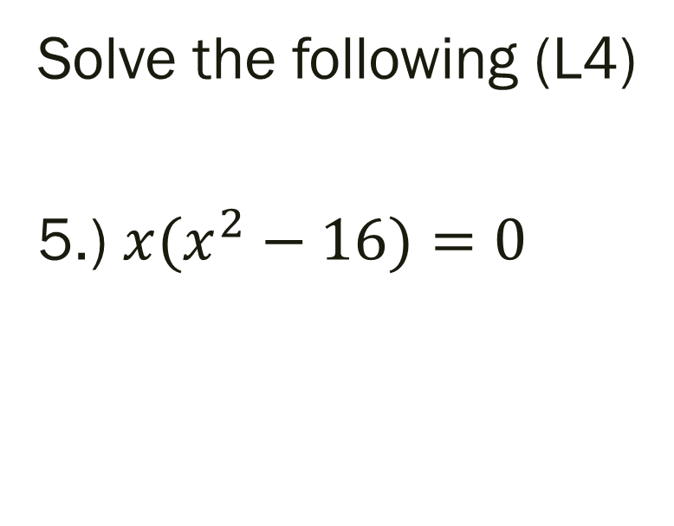
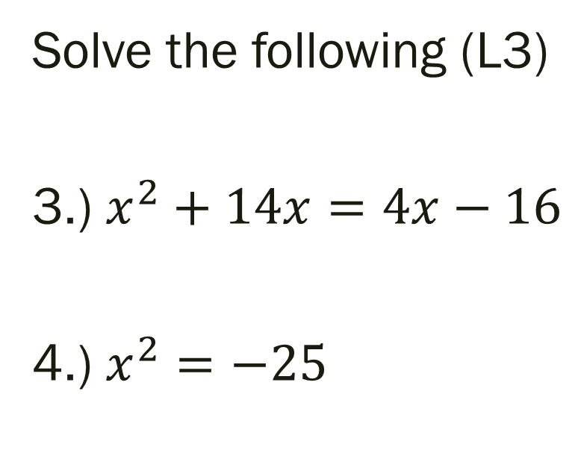
Unit 5 Quiz 1: Level 3 & 4
Solve the following (L3)
3.) $x^{2}+14x=4x−16$
4.) $x^{2}=−25$
Solve the following (L4)
5.) ${x(x}^{2}−16)=0$

